Slide 1


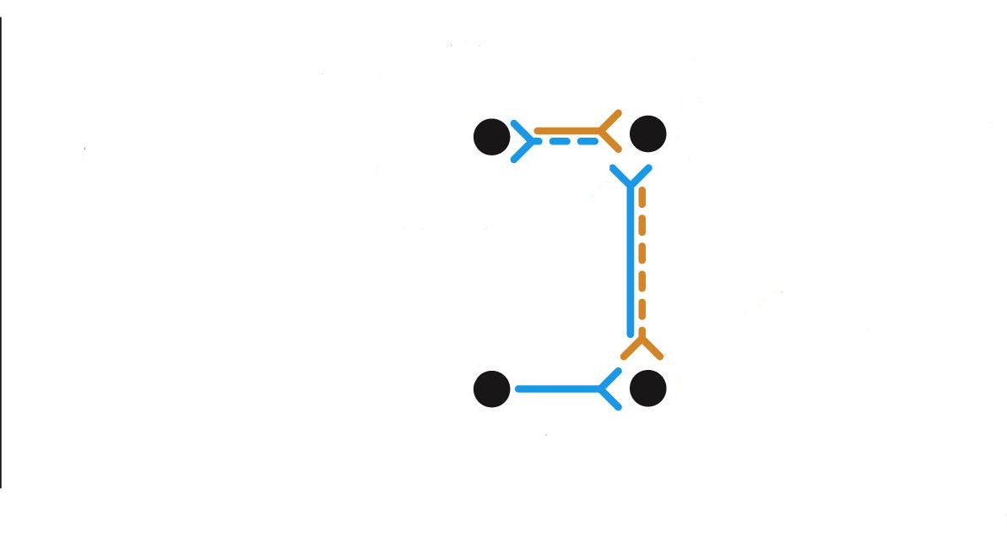
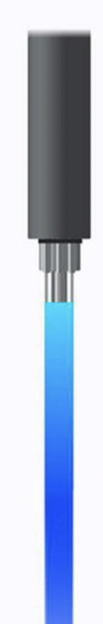
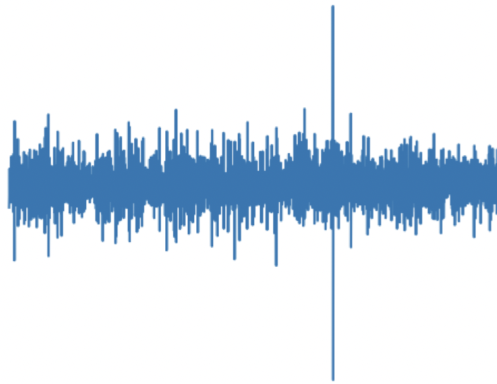

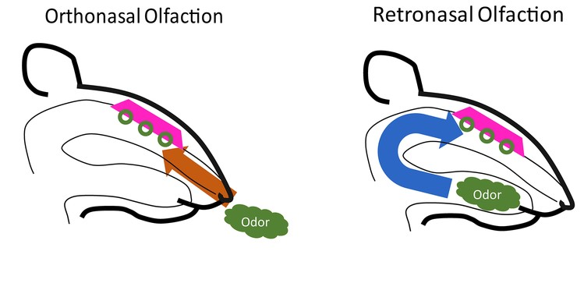
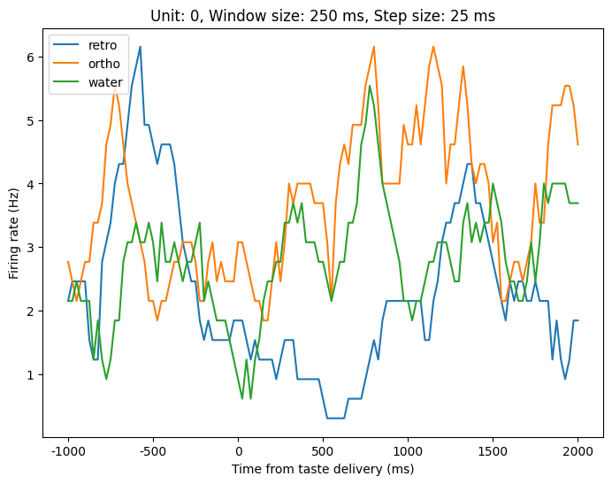
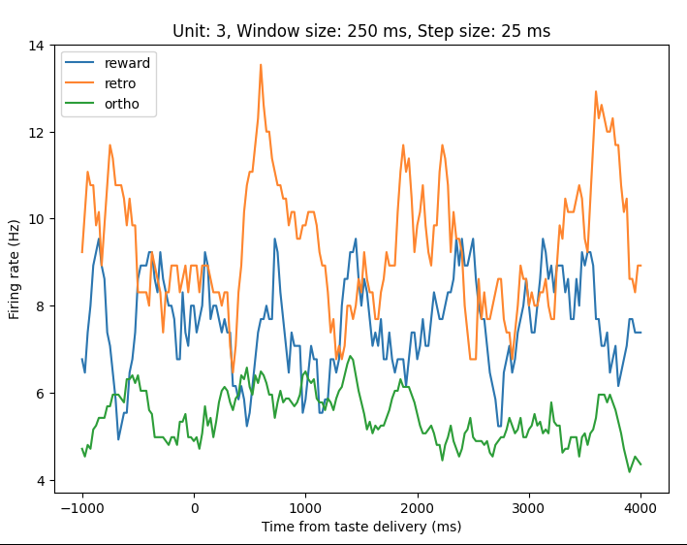
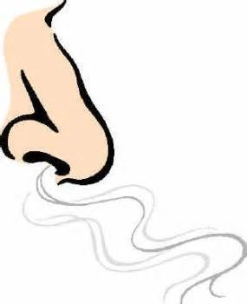
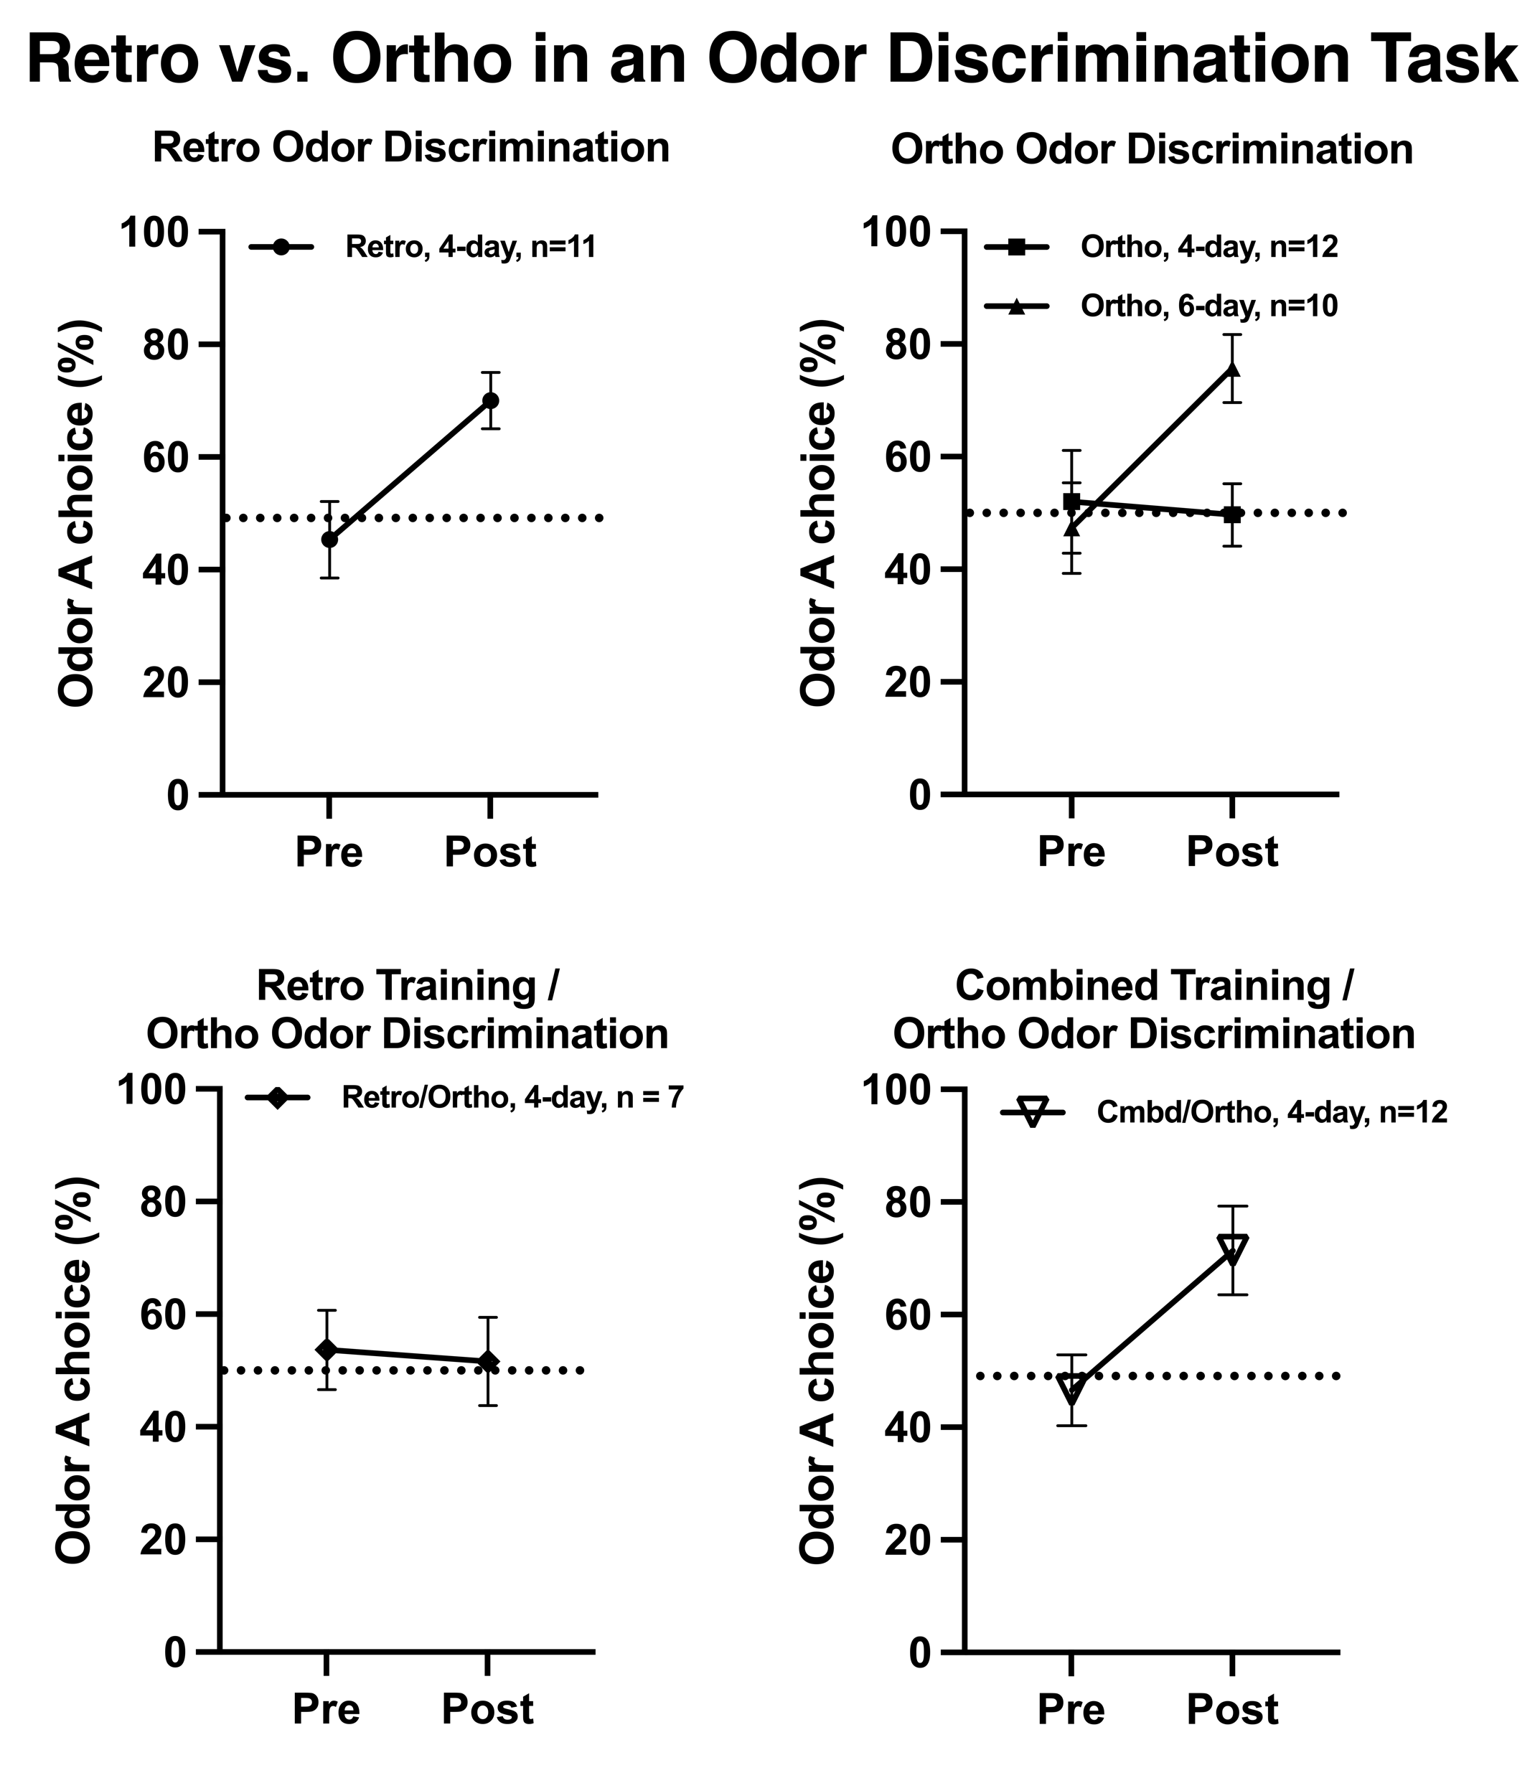
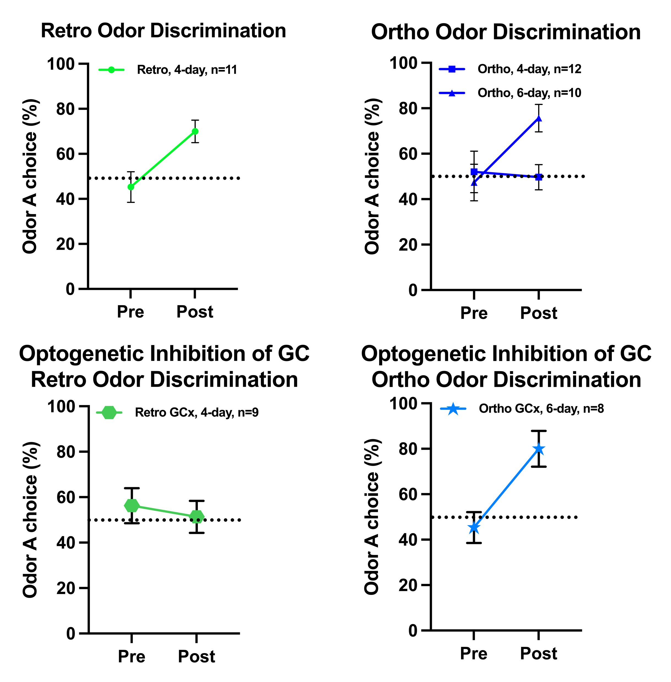
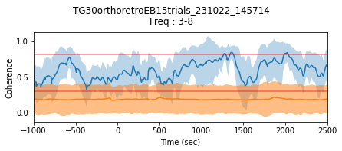
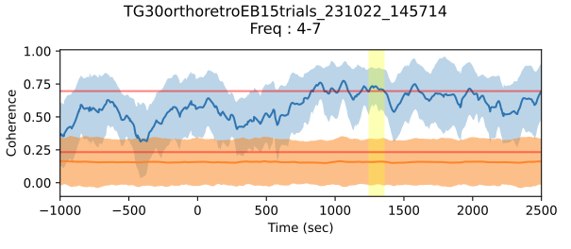
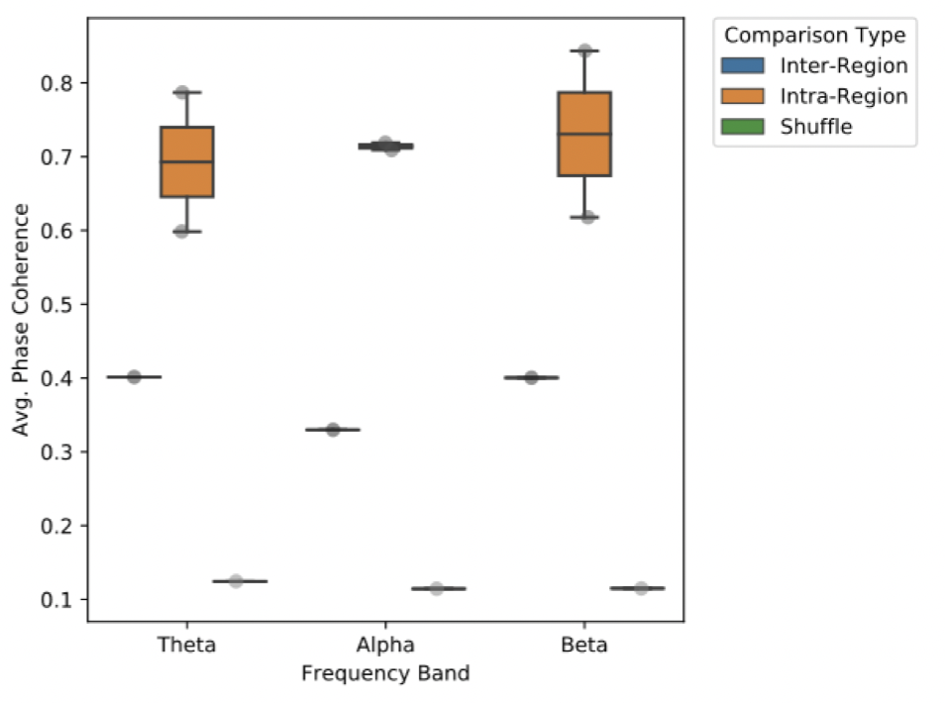
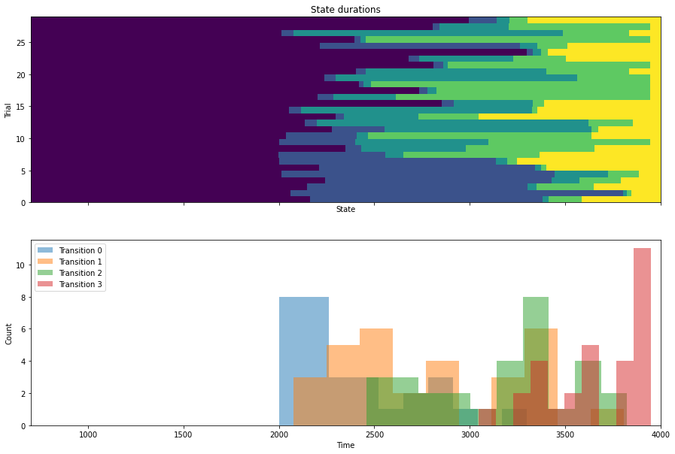
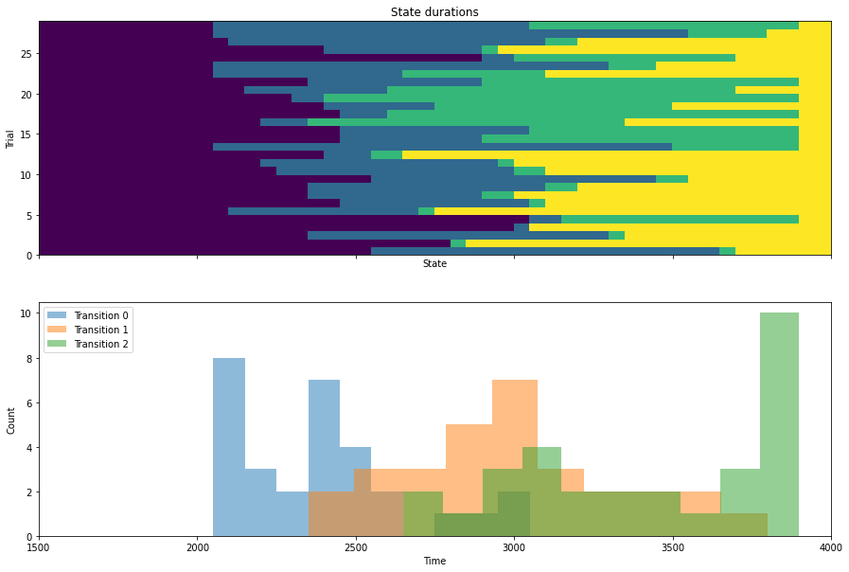
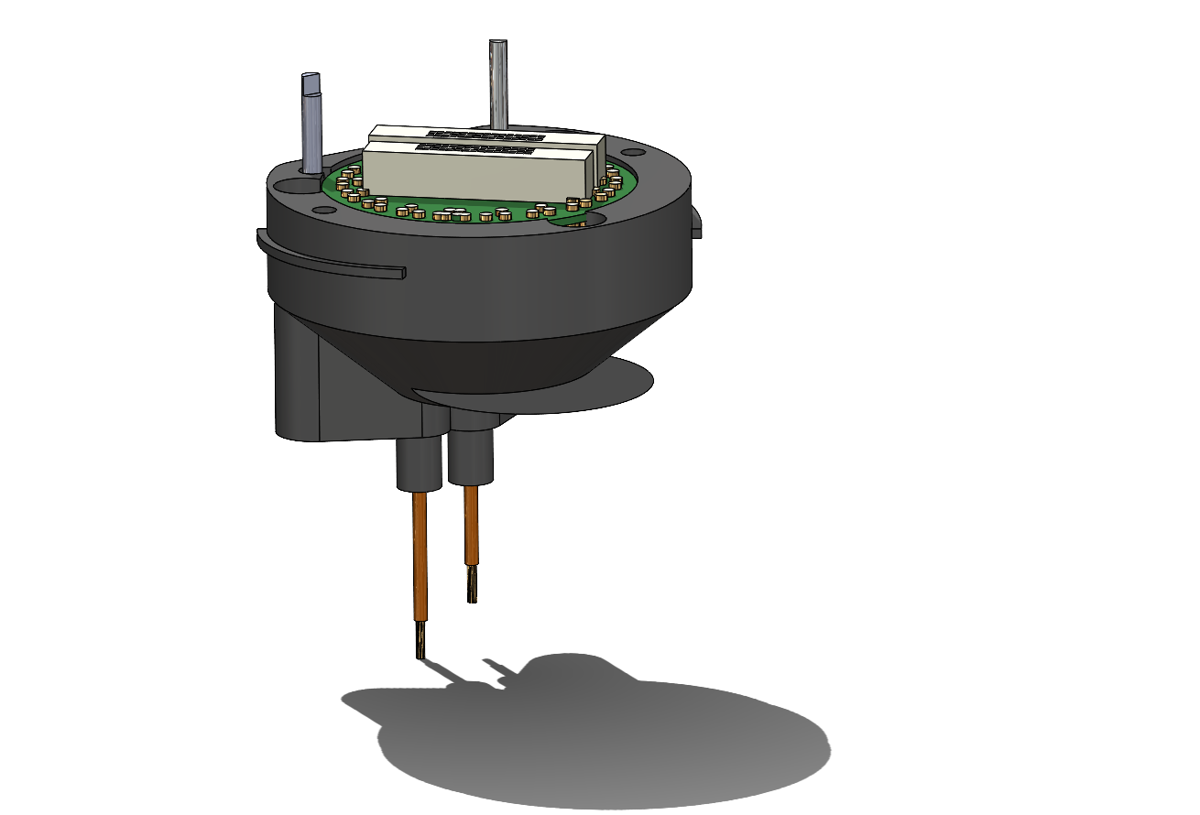
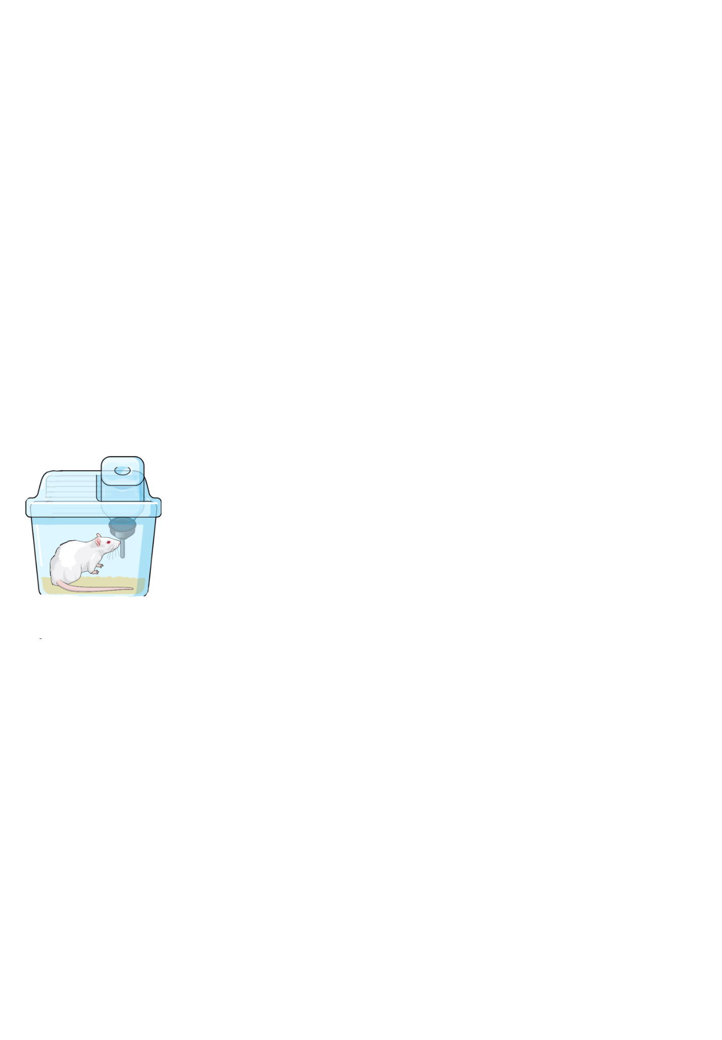
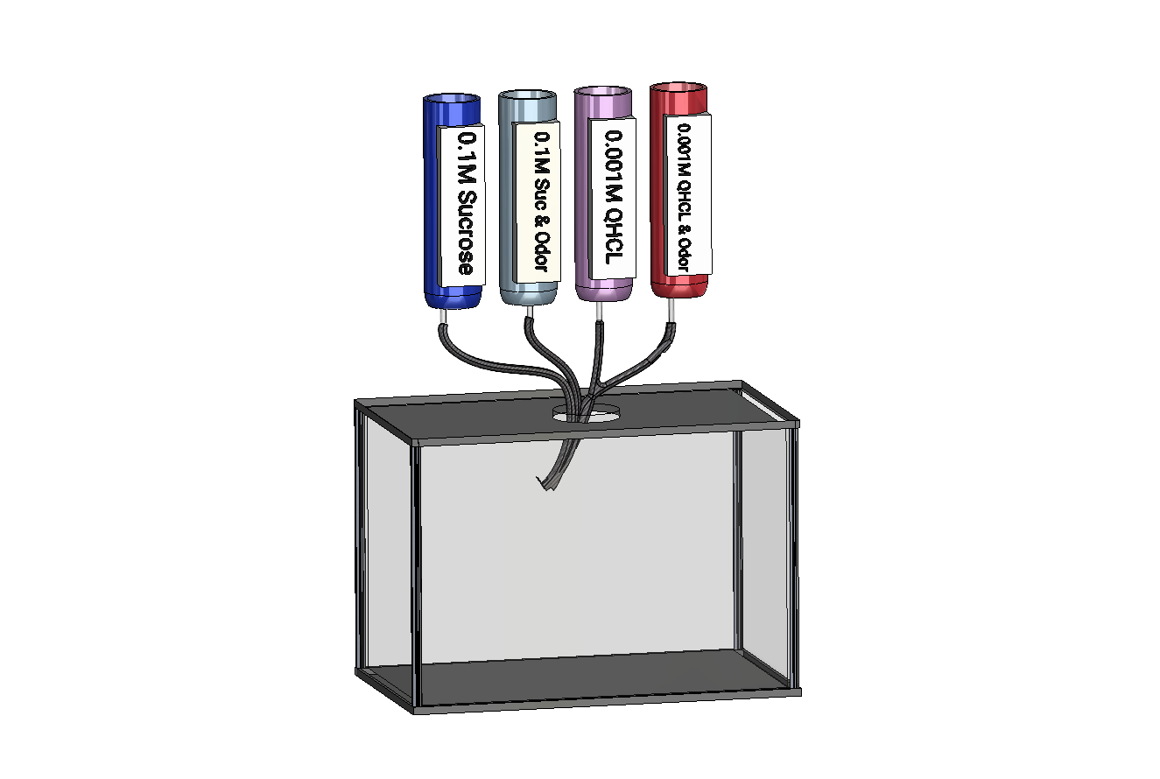
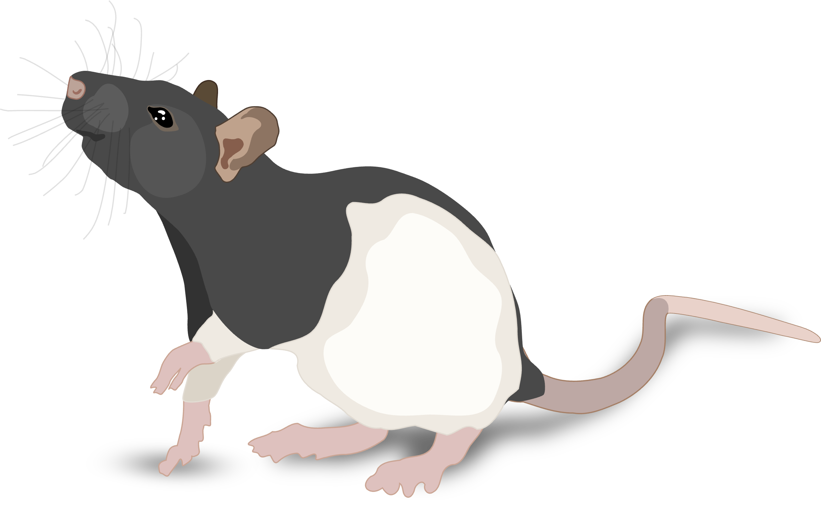
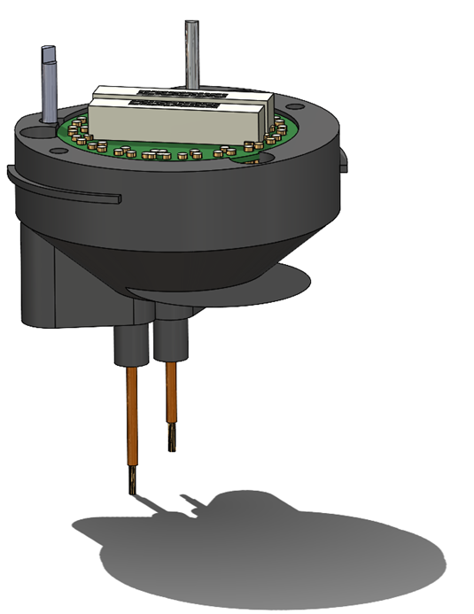
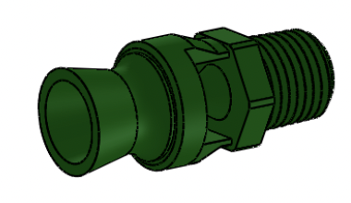
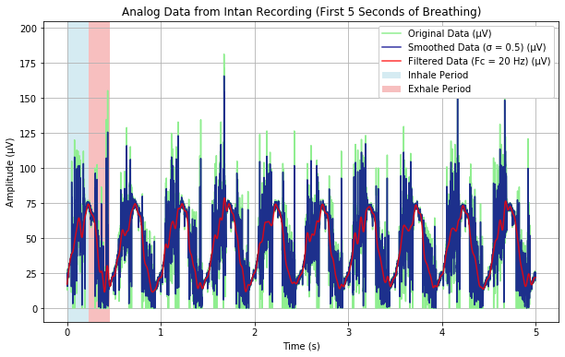
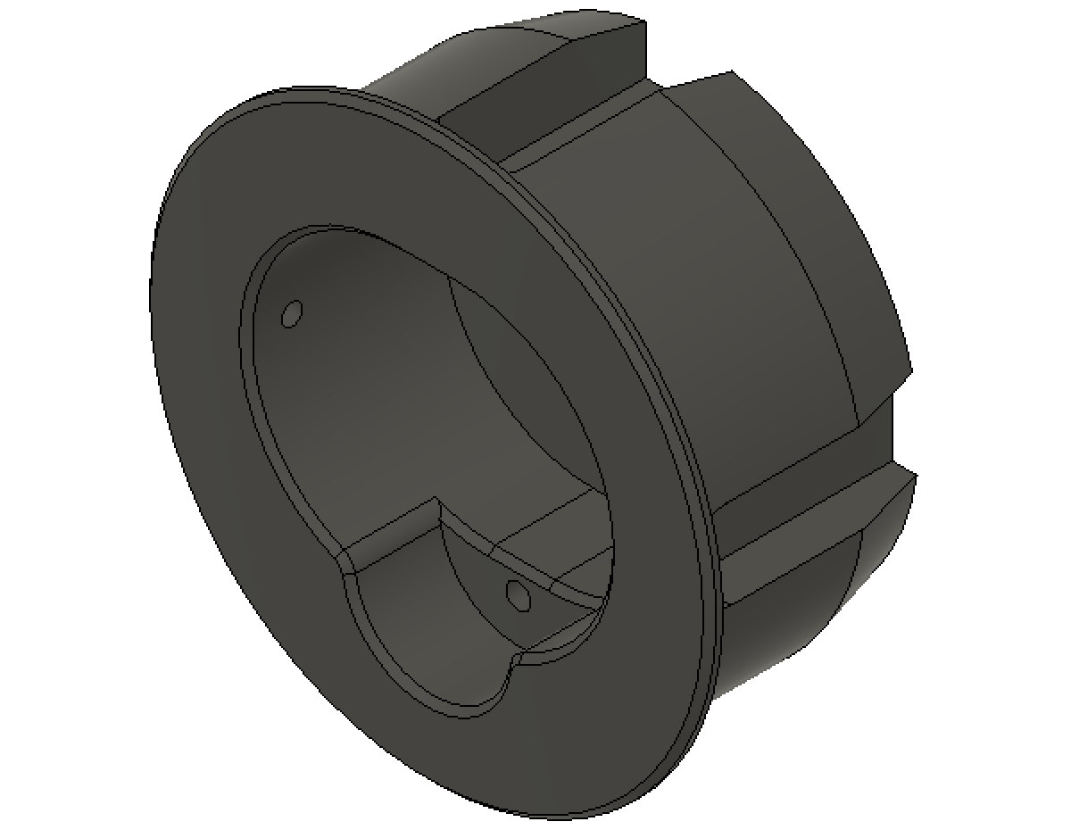


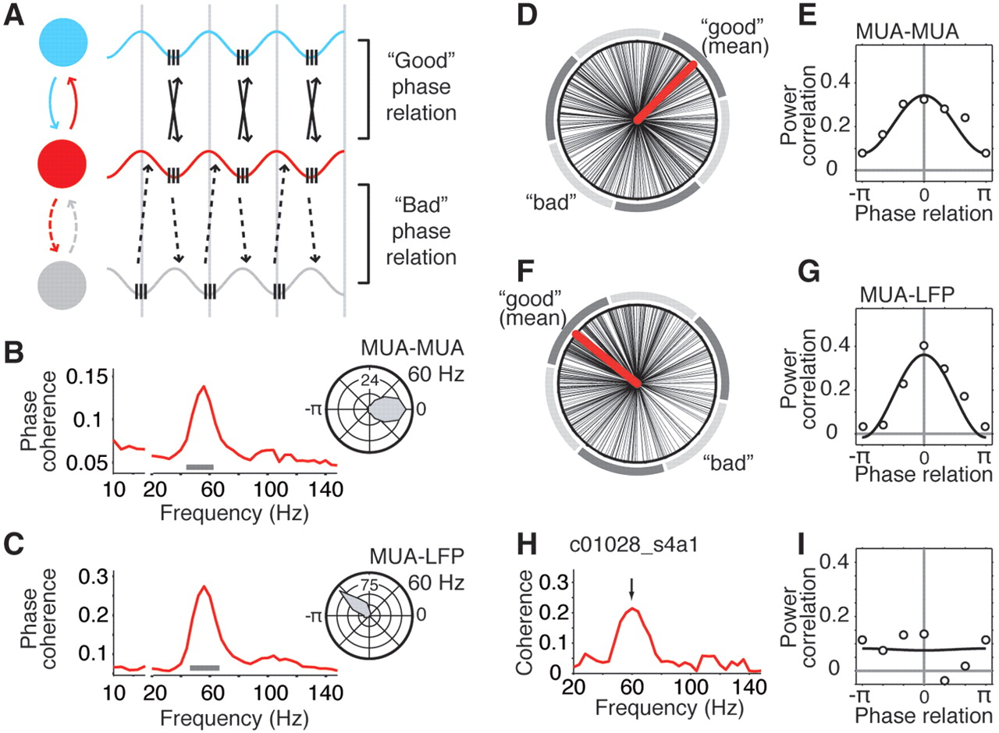
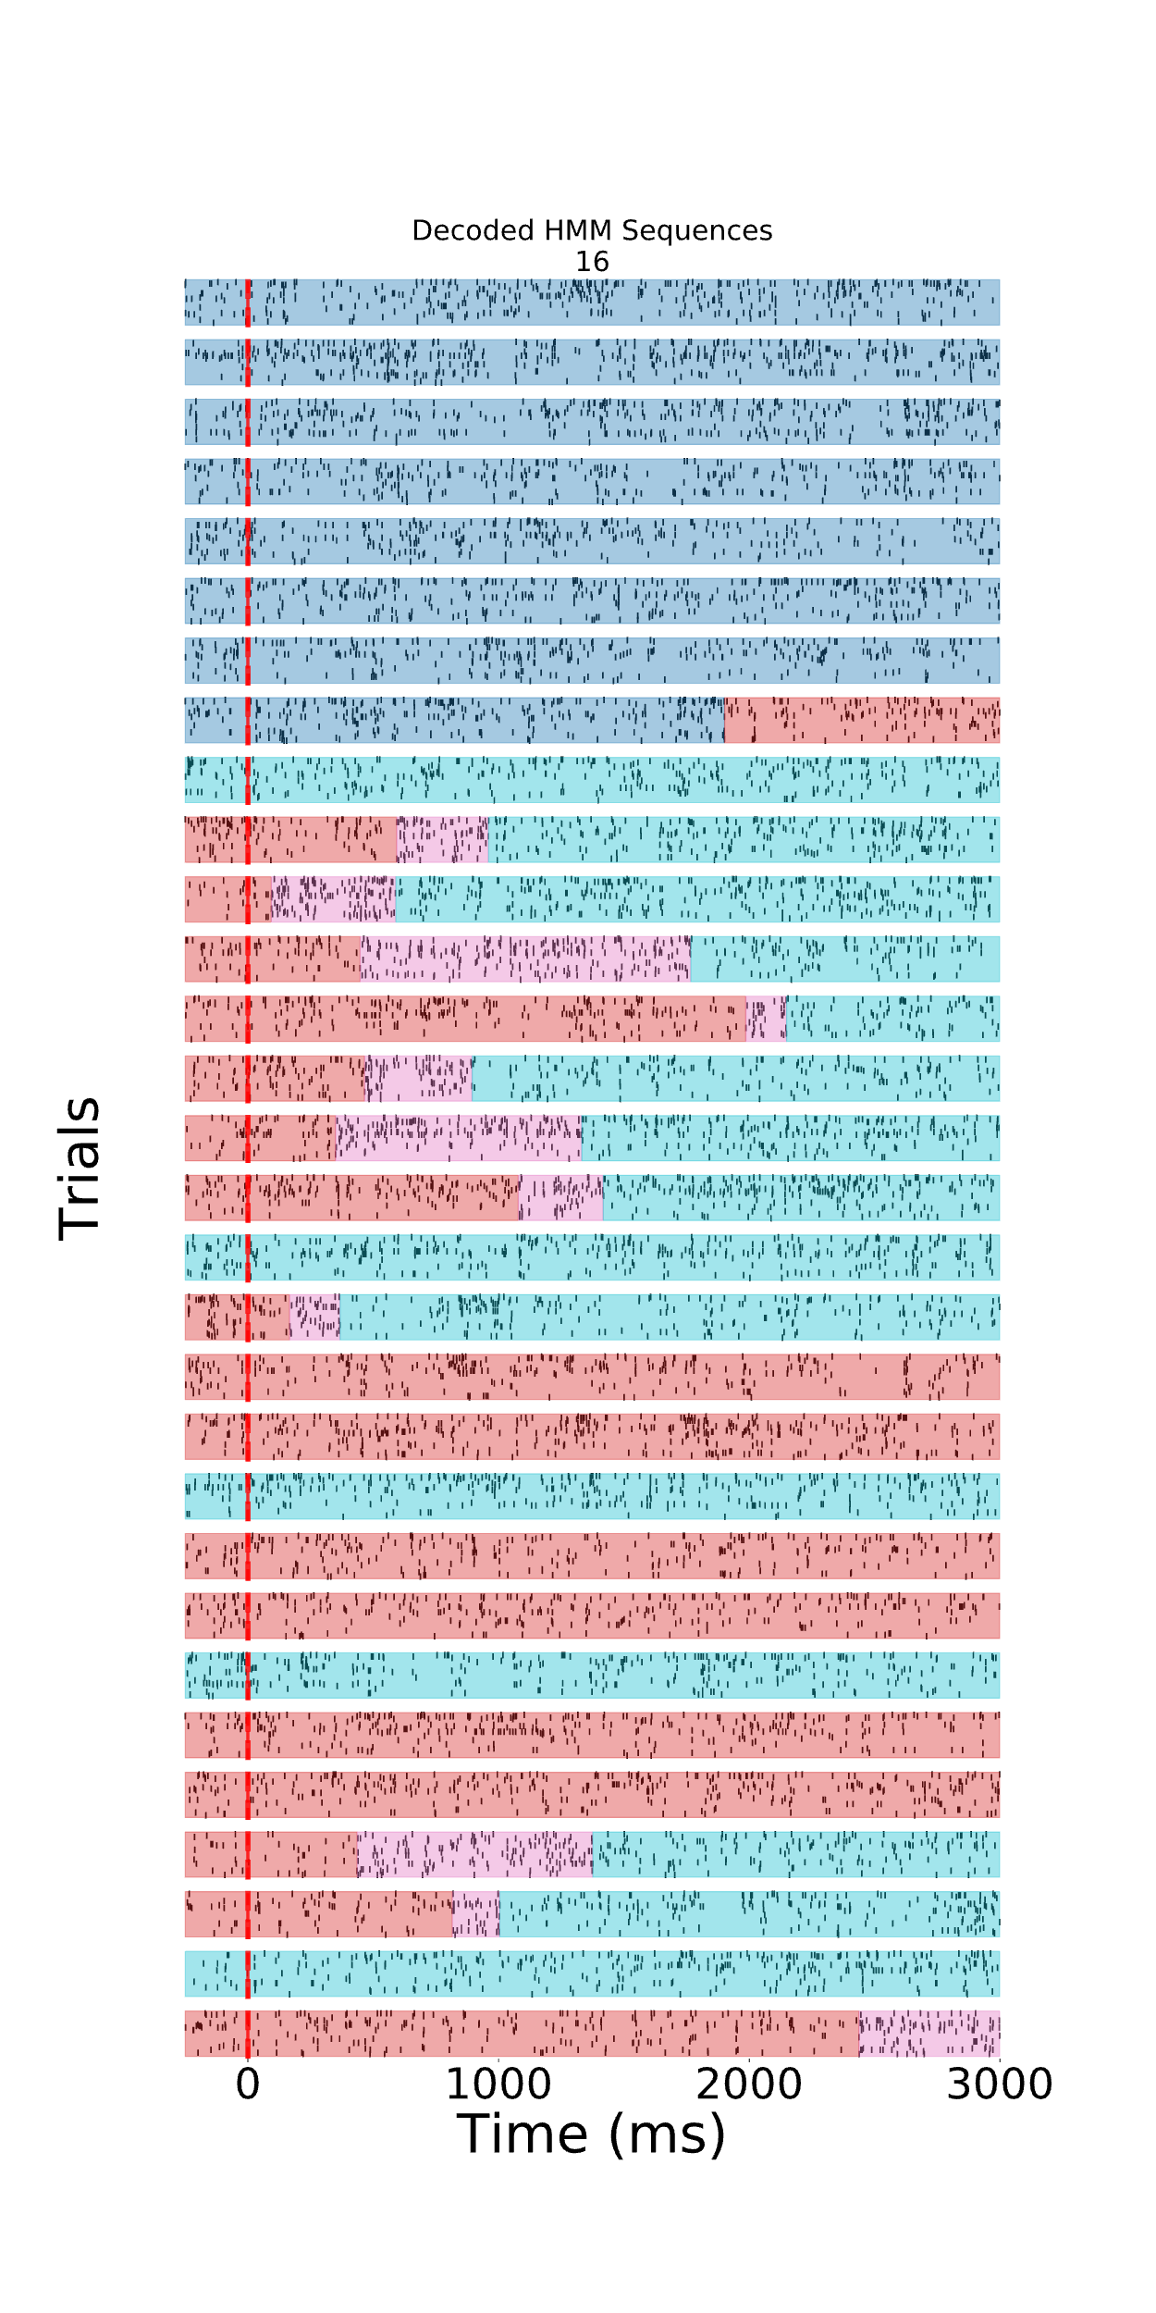
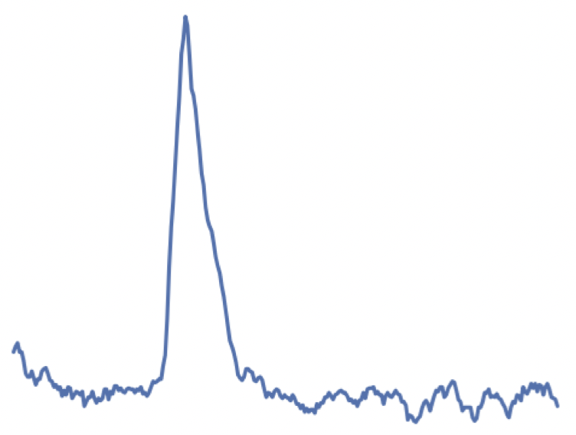
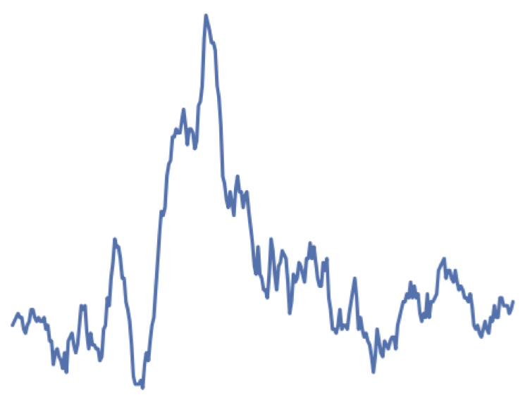
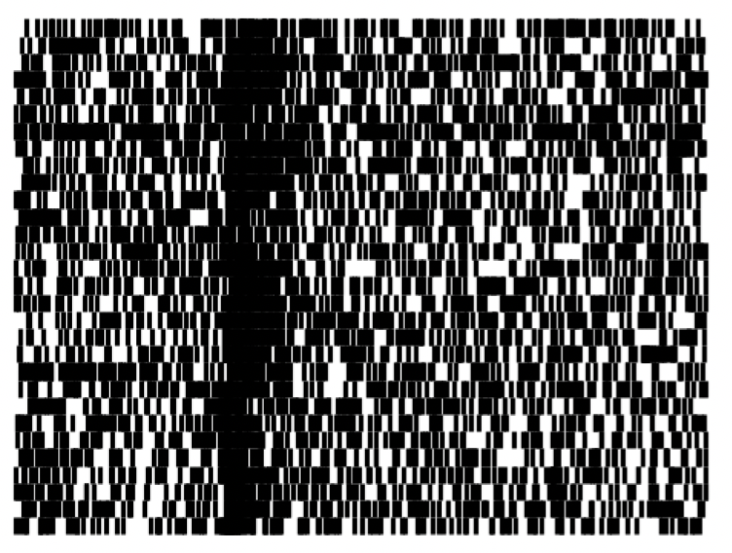
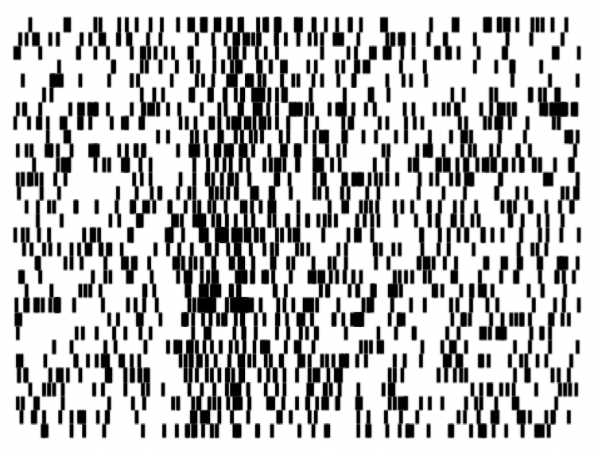
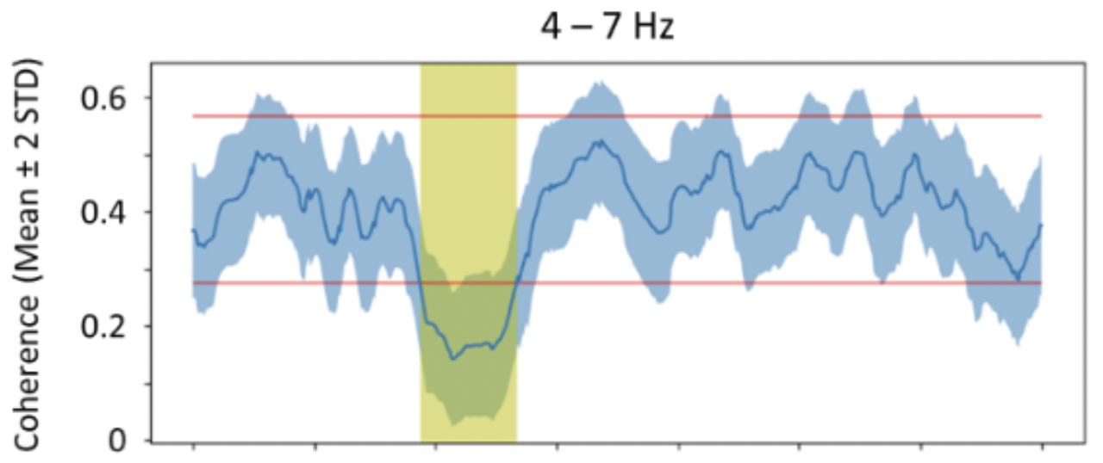
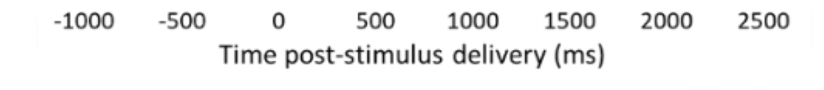
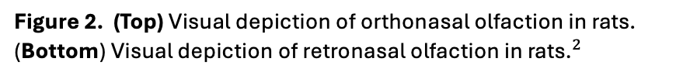
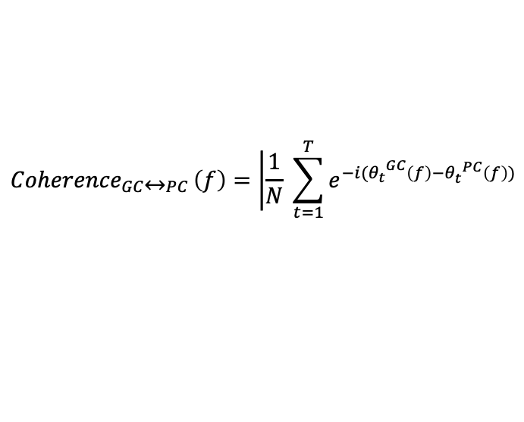
Differences in Retro- and Orthonasal Olfaction in Rat Chemosensory Cortices
Thomas R. Gray¹, Isaac Goldstein¹ and Donald B. Katz^{1,2}
1. Volen Center for Complex Systems 2. Psychology Department, Brandeis University, Waltham, MA
Introduction & Background
Results
Optogenetic Inhibition of Gustatory Cortex Influences Piriform Cortex
Orthonasal and Retronasal Olfaction in Mammals
Peri-Stimulus Time Histograms for GC and PC during Ortho- Retronasal Olfaction
VPMpc Thalamus
Gustatory Cortex
Orthonasal Olfaction
PSTH for GC Odor Responses
PSTH for PC Odor Responses
?
GC
Olfactory Bulb
Piriform Cortex
PC
Retronasal Olfaction
Figure 1. (Left) Solid lines demarcate a known connection and influence of one area on another. Dotted lines indicate an uncharacterized but predicted connection. (Right) Functional connectivity diagram of gustatory cortex (GC) and piriform cortex (PC) describing a previous experiment¹ where GC excitatory neurons were inhibited with optogenetics and PC neurons were recorded from with single channel electrodes.
Blankenship et al., 2019
Figure 2. (Top) Visual depiction of orthonasal olfaction in rats. (Bottom) Visual depiction of retronasal olfaction in ${\text{rats}\text{.}}^{2}$
Figure 8. (Top Left). Peri-stimulus time histogram showing GC representative neuron responses in hertz to retronasally delivered 0.01% ethyl butyrate in water, water, and orthonasally delivered ethyl butyrate at 0.01% concentration in mineral oil. Each stimulus was delivered 15 times. (Top Right) PSTH for PC response to to the same battery of stimuli as GC. These two examples were recorded in the same animal.
Optogenetic Inhibition of Gustatory Cortex Influences Piriform Cortex
Coherence between GC and PC LFPs during Ortho- and Retronasal Olfaction
Optogenetically inhibiting GC changes baseline activity in PC and changes odor responses
Orthonasal Coherence
Retronasal Coherence
Alpha Band (3-8Hz)
Alpha Band (3-8Hz)
Retronasal acquisition of odor discrimination learning happens faster than orthonasal
Optogenetically manipulating GC demonstrates that GC is required for retronasal but not orthonasal olfactory function.
Spike Correlation between Ortho- & Retronasal
Mean Inter, Intra, and Shuffle Coherence
0.8
Figure 3. (Top Left) Odor discrimination task using retronasally delivered odors. “Pre” training odor choice assessment followed by reward training for 4 days with Odor A and a “Post” training odor choice assessment. The dotted line represents a 50% of choosing Odor A over B (chance). (Top Right) Ortho discrimination task with 4 days of training and with 6 days of training. (Bottom Left) The same paradigm as above with optogenetic inhibition of GC. (Bottom Right) The same paradigm with optogenetic inhibition of GC.
0.7
Fraction of Significant Correlations
0.6
0.5
0.4
0.3
0.2
Adapted from Blankenship et al., 2019
0.1
Objectives
0.0
Ortho
Retro
Stimulus
Specific Aim: Characterize the dynamic activity between Gustatory Cortex and Piriform Cortex in response to retronasal olfaction and orthonasal olfaction and identify whether there is phase coherence.
Figure 9. (Top Left) LFP Coherence before and after stimulus delivery at time 0 s for orthonasal olfaction. (Top Right) Similarly the retronasal coherence over time with the highlighted area in yellow being significantly increased levels in coherence post stimulus delivery. (Bottom Left) The fraction of significant correlations between GC and PC spikes during ortho and retronasal olfaction. The lines below indicate the 75% range of correlations you would get by shuffling the data. (Bottom Right) Comparison of different LFP coherence over different frequency ranges in GC and PC to Retronasally delivered odors; in comparison the second and third positions indicate intra-region coherence and coherence when the LFP signalsa are shuffled.
Determine where in the odor response are LFP signals significantly coherent between GC and PC.
See whether GC and PC neuron pairs respond more coherently with orthonasal olfaction than retronasal olfaction.
Get insight on any directionality of cortical responses between GC and PC.
Changepoint Models for Orthonasal and Retronasal Olfaction
Retronasal
Orthonasal
Approach
Figure 10. (Top Left) Solid lines demarcate a known connection and influence of one area on another. Dotted lines indicate an uncharacterized but predicted connection. (Top Right) Functional connectivity diagram of gustatory cortex (GC) and piriform cortex (PC) describing a previous experiment¹ where GC excitatory neurons were inhibited with optogenetics and PC neurons were recorded from with single channel electrodes. . (Bottom Left) . (Bottom Right)
Experimental Protocol for Retronasal Delivery
Passive Retronasal Stimulus Delivery
Conclusions
Electrode Implant
Water Deprivation
IOC Delivery Habituation
Experimental Chamber
Retronasal stimulus
ITI: 20 - 30 s
20mL of water over 24hr
Water
Water
Odor 1
40 Trials = Water
40 Trials = EB in Water
Specific Aim: Characterize the dynamic activity between Gustatory Cortex and Piriform Cortex in response to retronasal olfaction and orthonasal olfaction and identify whether there is phase coherence.
Odor 2
Spont
Active Stimulus Delivery
LFP from GC and PC become coherent over the alpha band during the odor response around the palatability epoch of GC specific to the retro mode.
The fraction GC-PC neuron pairs that significantly correlate in firing are higher than chance in retronasal olfaction.
Based on preliminary data, we suggest GC leads PC in responses to retro odors.
Cue Light
ITI: 10 – 15 s
Orthonasal stimulus
3 s
Adapted from Eackermann / ratpack
Retronasal stimulus
2 s
Figure 5. (Left) Dual site drivable electrode array. 6 days after surgery rats are water deprived (given 20mL for 24 hours). On days 7 & 8, rats are given water through an intraoral cannula (IOC). (Right) On days 9-11, rats are given 0.01% Ethyl Butyrate dissolved in water, and water. Spontaneous activity (Spont) is also recorded as a control at the beginning of the experiment.
Reward
1 s
1 s
Future Directions
Experimental Protocol for Orthonasal Delivery
15 Trials = Water Reward
15 Trials = EB in Water/Ortho
Orthonasal Stimulus
Adapted from Maier et al., 2015
Alignment of Breathing to Electrophysiology
Water
Odor 1
Orthonasal stimulus & Retronasal stimulus
Orthonasal stimulus & Retronasal stimulus
Retronasal stimulus & Water
Odor 2
Spont
Day 1
Day 2
Day 3
To correctly align the onset of stimulus we plan to reanalyze the data using inhalation as stimulus onset instead of the odor delivery to the animal.
Reward Port
Figure 11. (Left) While gathering data we simultaneously record the pressure changes via analog signal and transform it to cycles of inhalation and exhalation. We then use this to algin the odor delivery as when the animal inhales while the odor is in the air.
Figure 6. (Left) Stimulus delivery protocol. Cue light signals water is available, then either a retro or ortho stimulus is delivered, and finally a water reward is delivered through the reward port. (Middle) Rat connected to IOC for retronasal odor deliveries. Orthonasal stimulus delivered via olfactometer³ and IR beam triggered reward port. (Right) Experimental protocol for active acquisition of ortho- and retronasal stimuli.
PSTH and Phase Coherence Analyses
Hidden Markov Models for Ortho vs. Retro State Transitions
Peri-Stimulus Time Histogram for a pair of GC and PC Neurons
Analysis Methods
Retronasal Odor Responses in GC
We plan to use Hidden Markov Models (HMMs) to find the state transitions along the odor response in GC and PC.
Peri-Stimulus Time Histograms
LFP Phase Coherence of GC and PC
Trial Shuffled Comparisons of Neuron Pairs
Changepoint Model of State Transitions during the odor response
Grainger Causality of State Transitions
Trial
60 Hz
PSTH
17 Hz
20 Hz
5 Hz
$${Coherence}_{GC↔PC }\left(f\right)=\left|\frac{1}{N}\right. \sum_{t=1}^{T}{e^{−i({θ_{t}}^{GC}\left(f\right)−θ_{t}^{ PC}\left(f\right))}}$$
From Womelsdorf et al., 2007
Time
Figure 11. (Left) While gathering data we simultaneously record the pressure changes via analog signal and transform it to cycles of inhalation and exhalation. We then use this to algin the odor delivery as when the animal inhales while the odor is in the air.
Trials
Equation 1. Phase coherence analysis can be performed using this , to evaluate the coupling between GC and PC LFPs during retronasal olfaction⁴.
Acknowledgments & Citations
Spike Raster
2000ms
We thank the Graduate Neuroscience Program and its staff. This work is supported by the NIDCD R01 Diversity Supplement (NIH 3R01DC007703-18S1) Brandeis Doctoral Training Grant “Neuroscience: From Channels to Behavior” (NIH 5T32MH019929-28). I would like to give thanks to Matt Wachowiak for designing and helping build the olfactometer, Joost Maier for giving invaluable insight on this project, and Don Katz for being a great mentor and teacher as I work through my thesis. This research was completed at Brandeis University. The Brandeis campus sits on land that was sacred to the Massachusetts nation, including four tribes existing today: the Mattakeeset, Natick, Ponkapoag, and Namasket. Both Native Americans and Africans were enslaved in the colony of Massachusetts.
[1] Maier et al. 2015. doi: 10.1016/j.cub.2015.08.060.; [2] Blankenship et al., 2019. doi:10.1016/j.cub.2018.11.011; [3] Womelsdorf et al., 2007. DOI: 10.1126/science.1139597; [4] Mahmood et al. 2022 in Review
Figure 7. (Left) Example of Peri-stimulus time histograms with corresponding spike raster below. (Right Top) Phase relation diagram demonstrating phase coherence. (Right Bottom) Example phase coherence analysis of GC and the Basolateral Amygdala during passive taste delivery. The blue is the phase coherence over time and the yellow is a significant deviation from baseline.

